Slide 1
Revised STAAR Alternate 2 Participation Requirements
Student Assessment Division
Texas Education Agency

Slide 2
Webinar Norms
Please make sure to keep your microphones muted.
Please send questions through the Q/A function. TEA is producing an FAQ document that will be posted soon.

Slide 3
Agenda
STAAR Alternate 2 Overview
USDE Statewide 1% Waiver Denial
STAAR Alternate 2 Participation Requirements
Frequently Asked Questions
Additional Resources

Slide 4
Webinar Goals
Provide an overview of STAAR Alternate 2
Provide an understanding of the United States Department of Education (USDE) Statewide 1% Waiver Denial
Provide local education agencies (LEAs) with accurate information and available resources pertaining to the revised STAAR Alternate 2 Participation Requirements

Slide 5
STAAR Alternate 2 Overview

Slide 6
What is STAAR Alternate 2?
The State of Texas Assessments of Academic Readiness (STAAR®) Alternate 2 is
an assessment based on prerequisite skills of the enrolled grade-level state curriculum standards, the Texas Essential Knowledge and Skills (TEKS);
designed to meet the needs of students with the most significant cognitive disabilities; and
developed to meet federal requirements of both the Every Student Succeeds Act (ESSA) and the Individuals with Disabilities Education Act (IDEA).

Slide 7
Who is assessed with STAAR Alternate 2?
Only students who meet the Texas Education Agency (TEA) definition of a student with the most significant cognitive disability may be assessed with STAAR Alternate 2 and who are enrolled in:
grades 3–8 or
specific high school courses—Algebra I, English I, English II, Biology, or U.S. History.
Students who meet participation requirements are assessed with STAAR Alternate 2 for all grades/subjects and courses.
The admission, review, and dismissal (ARD) committee is required to evaluate and make state assessment participation decisions annually.

Slide 8
TEA Definition of Student with the Most Significant Cognitive Disability
A student with the most significant cognitive disability:
Exhibits significant intellectual and adaptive behavior deficits in their ability to plan, comprehend, and reason, and who indicates adaptive behavior deficits that limit his or her ability to apply social and practical skills (e.g., personal care, social problem-solving skills, dressing, eating, using money) across all life domains.
Requires extensive, direct, individualized instruction and needs substantial supports that are neither temporary nor specific to a particular content area.

Slide 9
USDE Statewide 1% Waiver Denial

Slide 10
ESSA Waiver Denial Notification
(2023 Texas One Percent Waiver Denial Letter)

Slide 11
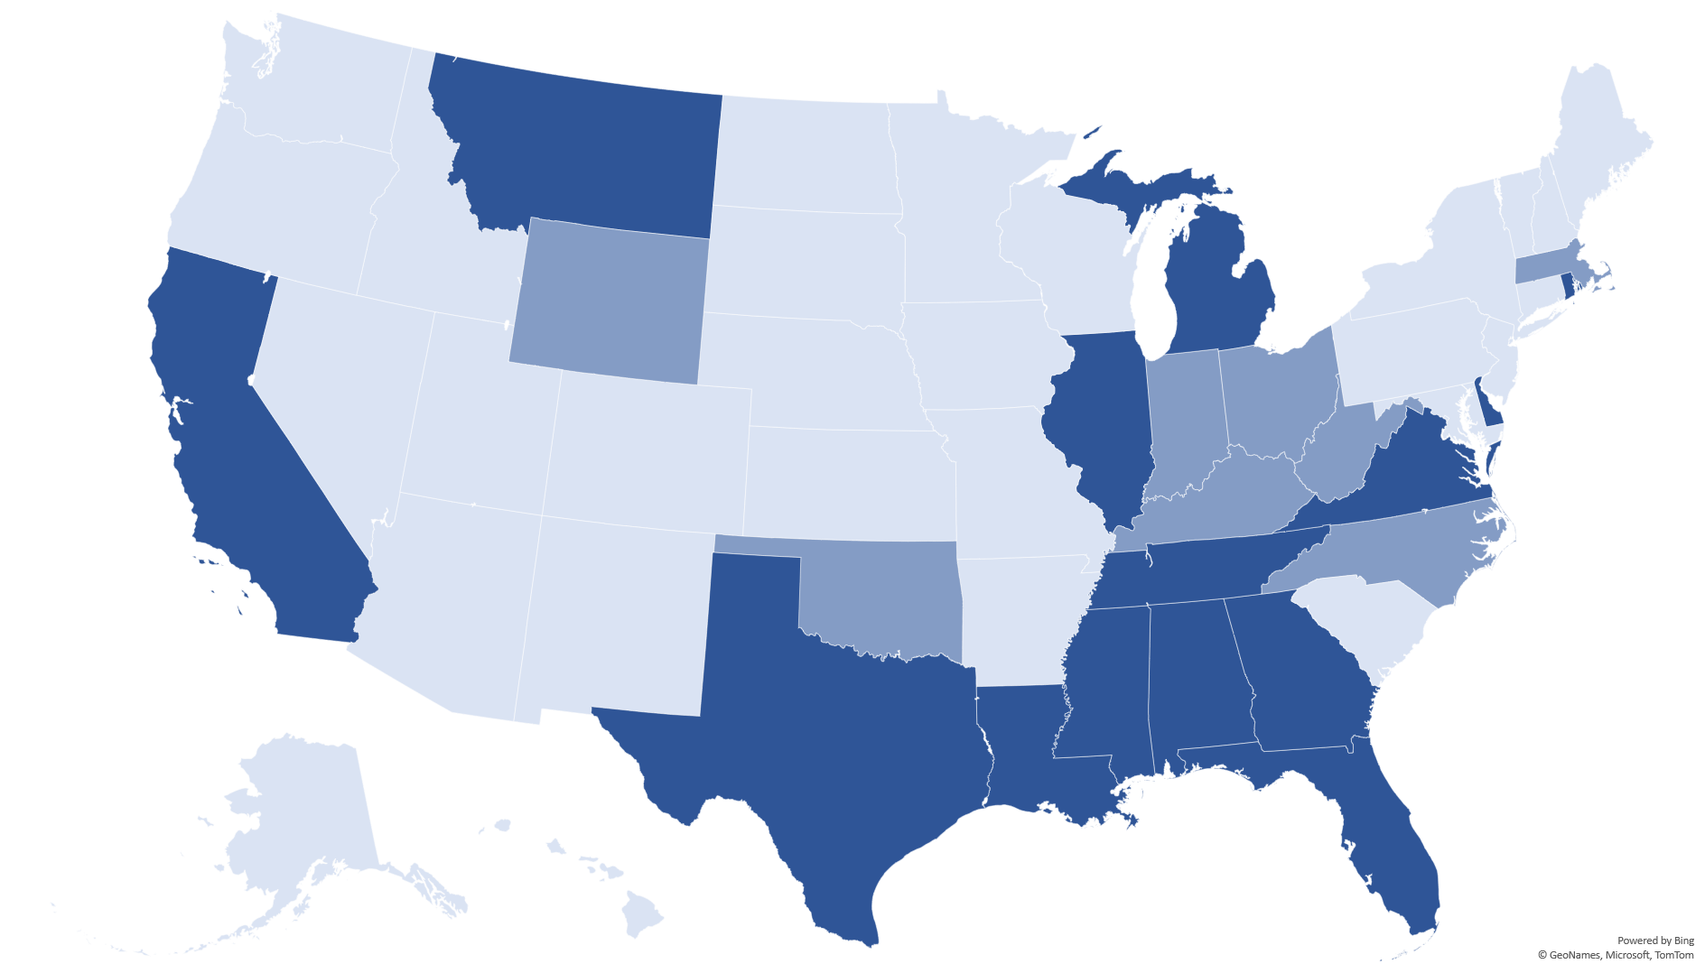
USDE Denial by State
In March of 2023, USDE denied the 1% waiver for 14 states (indicated in darker blue) for not making significant progress toward meeting the 1% state limit and/or not testing at least 95% of eligible students.
Eight states saw their waiver approved for making 'significant progress' towards reaching the 1% state limit.

Slide 12
Frequently Asked Question 1
Does the 1% cap apply to individual districts or campuses?
No. The 1% cap on students participating in the alternate assessment applies to the state. LEAs who are over 1% student participation are required to complete a justification and assurances form to indicate LEA specific information as to why more than 1% of students were assessed using the alternate assessment.

Slide 13
Revised STAAR Alternate 2 Participation Requirements, cont.
WHEN AND WHO | WHY
In August 2023, STAAR Alternate 2 Participation Requirements were revised using recommendations and feedback that included the following stakeholders across the state: Special education educators and administrators ESC administrators and specialists Special education advocates TEA Special Populations personnel | The purpose of revising the participation requirements was to clarify the scope of students that are assessed with STAAR Alternate 2 and satisfy ESSA requirements.

Slide 14
STAAR Alternate 2 Participation Requirements

Slide 15
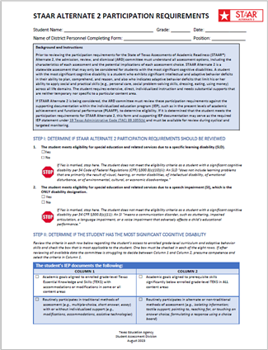
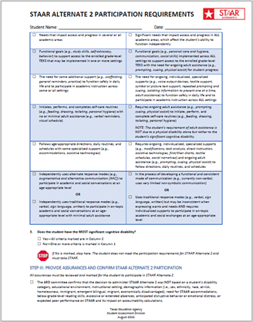
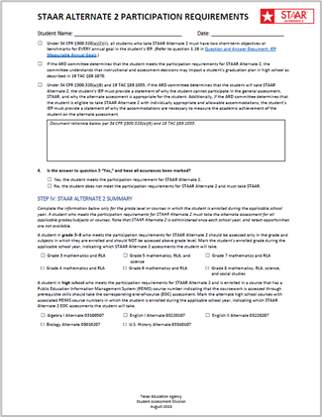
STAAR Alternate 2 Participation Requirements (continued)

Slide 16
Background and Instructions
The ARD committee must review state assessment decisions annually.
The ARD committee must understand all assessment options, including the characteristics of each assessment option and the potential implications of each assessment option.

Slide 17
Background and Instructions (continued)
What data does the ARD committee need to consider to determine a student's eligibility for STAAR Alternate 2?
To determine a student's eligibility, the ARD committee must review the participation requirements against the supporting documentation within the student’s individualized education program (IEP), such as the present levels of academic achievement and functional performance (PLAAFP).
Is there other data or documentation that an ARD committee may consider?
Yes. Documentation is not limited to the student’s full individual evaluation (FIE) or PLAAFP. The ARD committee may also consider other sources of evidence such as parent and teacher observations and data, the student's goals and objectives, and progress monitoring data. For additional sources of evidence that may be used, refer to the Companion Document.

Slide 18
Step I: Determining Eligibility
Step I includes two statements to determine if the ARD committee should proceed to Step II.

Slide 19
Step II: Determining Eligibility
The information selected means that it is documented in the student’s IEP.
The ARD committee must review the criteria in each row in this section regarding the student’s access to enrolled grade-level curriculum and adaptive behavior skills and check the box that is most applicable to the student.
One box must be checked in each of the eight rows.
If after reviewing all available data the committee is struggling to decide between Column 1 and Column 2, presume competence and select the criteria in Column 1.

Slide 20
Step II: Row 1
The ARD committee should ask the question:
Does the student access ALL enrolled grade-level TEKS through prerequisite skills, including math, reading language arts, science, social studies, and any other TEKS based course?

Slide 21
Step II: Row 2
The ARD committee should ask the question:
Does the student routinely require alternate or non-traditional methods of assessment?

Slide 22
Step II: Row 3
The ARD committee should ask the question:
The ARD committee should ask the question:
How significant are the student’s needs in relation to how they impact access and progress in all academic areas, which affect the student’s level of independence?

Slide 23
Step II: Row 4
The ARD committee should remember:
Any student with an IEP can have functional goals identified. The functional goals listed in Column 2 are needs so pervasive that without ongoing adult assistance the student is unable to function independently.

Slide 24
Step II: Row 5
The ARD committee should ask the question:
How extensive is the support required for the student to function safely in daily life and participate in academic instruction across ALL settings?

Slide 25
Step II: Row 6
The ARD committee should remember:
The ARD committee should ask the question:
Other self-care routines may include, but are not limited to, tasks such as: brushing teeth, bathing, selecting appropriate clothing for the weather, washing hands, determining an appropriate meal, transitioning safely in the hallway or between classes, etc.
How extensive and frequent is the adult support required for the student to initiate, perform, and complete self-care routines?

Slide 26
Frequently Asked Question 2
My student can______ independently, can they still participate in STAAR Alternate 2?
It is important to look at what independence looks like for the student. What level of support is the adult providing so the student can initiate, perform, and complete the self-care routine?
Are there supports, such as:
Visual, verbal, physical prompts
Cueing
Visual schedules
Timers
Adult transition support
Adult physical support
Task analysis
If a student requires any of these example supports on an ongoing basis, then the student is not independently initiating, performing, or completing self-care routines.

Slide 27
Step II: Row 7
The ARD committee should ask the question:
How extensive and frequent is the adult support required for the student to follow directions, daily routines, and schedules?

Slide 28
Step II: Row 8
The ARD committee should ask the question:
How extensive and frequent are the individualized supports required for the student to participate in on-topic and age-appropriate academic and social exchanges?

Slide 29
Step II: Review Criteria
The ARD committee will need to determine if the student has the most significant cognitive disability after reviewing all the criteria, completing each row, and selecting the appropriate response.
Based on the response to Question 3, the ARD committee will either move on to the next step or stop on Step II.
Remember that a student with the most significant cognitive disability requires extensive, direct, individualized instruction, as well as a need for substantial supports that are neither temporary nor specific to a particular content area.

Slide 30
Step III: Provide Assurances and Confirm
All assurances must be reviewed and marked for the student to participate in STAAR Alternate 2.
The ARD committee will also need to respond to Question 4 to either confirm or not confirm the student’s eligibility for STAAR Alternate 2.

Slide 31
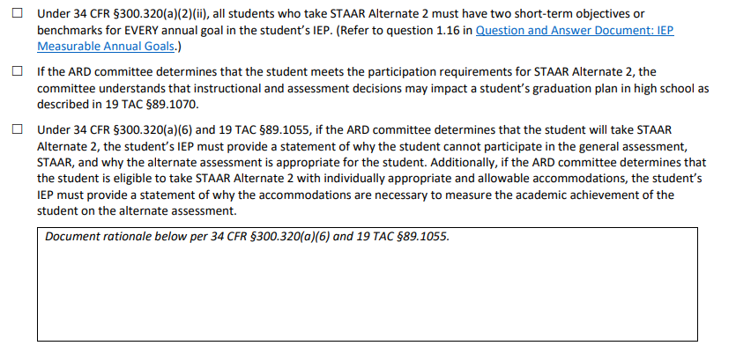
Frequently Asked Question 3
What needs to be included in the rationale box? How specific do I need to be?
The rationale needs to include:
A statement about why the student cannot participate in STAAR and why the alternate assessment is appropriate and
A statement of necessary allowable accommodations.
Each row in the participation requirements does not need to be individually addressed in the rationale box because they will have already been discussed and completed in Steps I and II.

Slide 32
Step IV: STAAR Alternate 2 Summary
The ARD committee needs to complete the information only for the grade level or courses in which the student is enrolled during the applicable school year.
A student who meets the participation requirements for STAAR Alternate 2 must take the alternate assessments for all applicable grades/subjects or courses.
STAAR Alternate 2 is administered once each school year, and retest opportunities are not available.

Slide 33
Frequently Asked Questions Section

Slide 34
Frequently Asked Question 4
My student no longer meets eligibility for STAAR Alternate 2, will his or her special education programming need to change?
If a student is not eligible to take the alternate assessment, the ARD committee is responsible for educating the student in the least restrictive environment while still addressing the student’s needs and critical skills (goals and short-term objectives).
A student may have a significant cognitive disability but does not meet the criteria as having the most significant cognitive disability. The ARD committee will determine the programming that is most appropriate to ensure access to and progress in the general curriculum. For some students this may mean their programming does not change, but that is an ARD committee decision and TEA cannot provide guidance on the frequency, duration, or location of individual students’ special education supports and services.
Staffing considerations for individual students are an ARD committee decision.

Slide 35
Frequently Asked Question 5
My student no longer meets eligibility for STAAR Alternate 2, can he or she still receive instruction at the prerequisite or modified level?
Yes. The student's ARD committee will continue to determine how the student will receive instruction. It is possible that a student will take STAAR while accessing the enrolled grade-level TEKS through modifications and/or prerequisite skills.
Only students who meet the participation requirements and will take STAAR Alternate 2 EOC assessments can be associated with the alternate course codes in PEIMS for Algebra I, English I, English II, Biology, and U.S. History.

Slide 36
Frequently Asked Question 6
My student has always taken STAAR Alternate 2 but no longer meets the participation requirements. What happens if my student takes STAAR and does not pass? Is he or she required to receive accelerated instruction?
Texas law requires all students who do not achieve Approaches Grade Level or higher on STAAR to be provided accelerated instruction. These requirements were recently updated with the passage of House Bill 1416, 88th Texas Legislature, Regular Session, 2023.
A parent may elect to modify or remove a requirement for the accelerated instruction by submitting a written request to the administrator at the campus in which the student is enrolled. To request the change, the student must have been administered and failed to perform satisfactorily on STAAR or administered a beginning-of-year assessment aligned with the TEKS for that grade/subject or course. An LEA may select a beginning-of-year assessment designed to show grade level proficiency on the TEKS. A student who does not have a failed STAAR assessment must be administered a beginning-of-year assessment for the parent to be able change the requirements.
Additionally, an ARD committee may be convened if the committee feels that the student’s IEP needs to be modified based on the accelerated instruction requirements.

Slide 37
Frequently Asked Question 7
Does the ARD committee have to meet again if the committee had already reviewed and determined participation for the 2023–2024 school year using the previous STAAR Alternate 2 participation requirements?
It depends. The ARD committee must review and determine student participation in STAAR or STAAR Alternate 2 for each school year. If the ARD committee has already reviewed and determined participation for the 2023–2024 school year using the previous STAAR Alternate 2 participation requirements, district personnel must review all eligible students to determine if any STAAR Alternate 2 decisions need to be re-evaluated based on the revised participation requirements.
For those students whose participation needs to be re-evaluated based on the updated participation requirements, assessment participation decisions may be made through an ARD amendment in accordance with 34 CFR §300.324(a)(i) or a full ARD meeting.
For any future assessment participation decisions, the ARD committee should use the updated STAAR Alternate 2 participation requirements.

Slide 38
Frequently Asked Question 8
My student meets the participation requirements for STAAR Alternate 2 in some areas but not all; is he or she still required to take STAAR?
Yes. Remember that the definition of a student with the most significant cognitive disability requires extensive supports in all areas not just in particular subject areas.
Students must meet the participation requirements in ALL subject areas to be eligible to take STAAR Alternate 2.

Slide 39
Frequently Asked Question 9
I have only ever given STAAR Alternate 2 but now have a student who needs to take STAAR; do I need to be trained in administering both assessments?
Yes. If you will be administering both types of assessments, you will need to be trained in test security and administration procedures specific to each assessment program. All district personnel who participate in state-mandated testing or handle secure test materials and content are required to be trained at least once in test security and administration procedures for the applicable assessment.
If the student is also eligible for assessment accommodations, the test administrators must understand the proper implementation of the accommodations.

Slide 40
Frequently Asked Question 10
My student is eligible for special education services based on only a speech impairment (SI) but meets all other requirements in Step II; can he or she take STAAR Alternate 2?
No. Remember that STAAR Alternate 2 is authorized under federal law for students with the most significant cognitive disabilities. A student who is identified with only a speech impairment would not meet eligibility requirements as a student with a cognitive disability.
This is why the STAAR Alternate 2 participation requirements indicate that if a student is identified with only SI, then the student is not eligible to participate in STAAR Alternate 2.
If an LEA believes that a student still meets all criteria in Step II under Column 2, then the ARD committee may need to address whether additional student evaluations may be needed.

Slide 41
Additional Resources

Slide 42
STAAR Alternate 2 Participation Requirements Resources
Resource | Purpose | Audience
STAAR Alternate 2 Participation Requirements | Used by the ARD committee to determine if a student meets the eligibility requirements to participate in STAAR Alternate 2. The form is available in English and Spanish. | Administrators, Coordinators, Teachers, Parents
STAAR Alternate 2 Companion Document | Used in conjunction with STAAR Alternate 2 Participation Requirements. Sources of evidence for a student’s eligibility for STAAR Alternate 2 are on page 2 of this document. The document is available in English and Spanish. | Administrators, Coordinators, Teachers, Parents
STAAR Alternate 2 Participation Requirements FAQs | Will include frequently asked questions and answers related to the updated STAAR Alternate 2 Participation. (Coming soon on the STAAR Alternate 2 Resources webpage.) | Administrators, Coordinators, Teachers
STAAR Alternate 2 Overview and Eligibility Training | Assists the ARD committee in better understanding the unique features of STAAR Alternate 2, and thereby, in determining the most appropriate assessment for each student. (Coming soon in the Learning Management System.) | Administrators, Coordinators, Teachers
STAAR Alternate 2: Before, During, and After the Assessment Course | Is designed for new test administrators to be helpful in understanding the testing process and may also serve as a refresher to experienced test administrators. (Coming soon on the TEA Learn webpage.) | Administrators, Coordinators, Teachers

Slide 43
Texas Assessment Educator Committees
Classroom teachers, instructional coaches, campus and district content specialists, and campus administrators can serve in a variety of ways:
Educator item review—each potential question for a state test is reviewed and approved by a committee of Texas educators
Subject-area advisory groups—groups of educators are convened to provide feedback on subject-area-specific topics
https://www.texasassessment.gov/educator-committees.html

Slide 44
TEA Contact Information
For inquiries related to development, administration, scoring, and reporting of state assessments please contact:
Student Assessment Help Desk
(512) 463-9536
https://tea.Texas.gov/student.assessment/

Slide 45
Disclaimer
These slides have been prepared by the Student Assessment Division of the Texas Education Agency. You are encouraged to use them for local training.
If any of the slides are changed for local use, please hide or remove any TEA logos, headers, or footers. (You may need to edit the Master slide.) In addition, you must remove the photographs. Only TEA has parental permission to use these photographs for training purposes.
This training is not intended to replace any materials or additional information on the TEA website.

Slide 46
Thank you!
Thank you!

